Slide 1
ERNIE INTERNE ED ULCERE MARGINALI
DOTT.SSA STEFANIA NIGRO
A.O.U. G. MARTINO- MESSINA

Slide 2
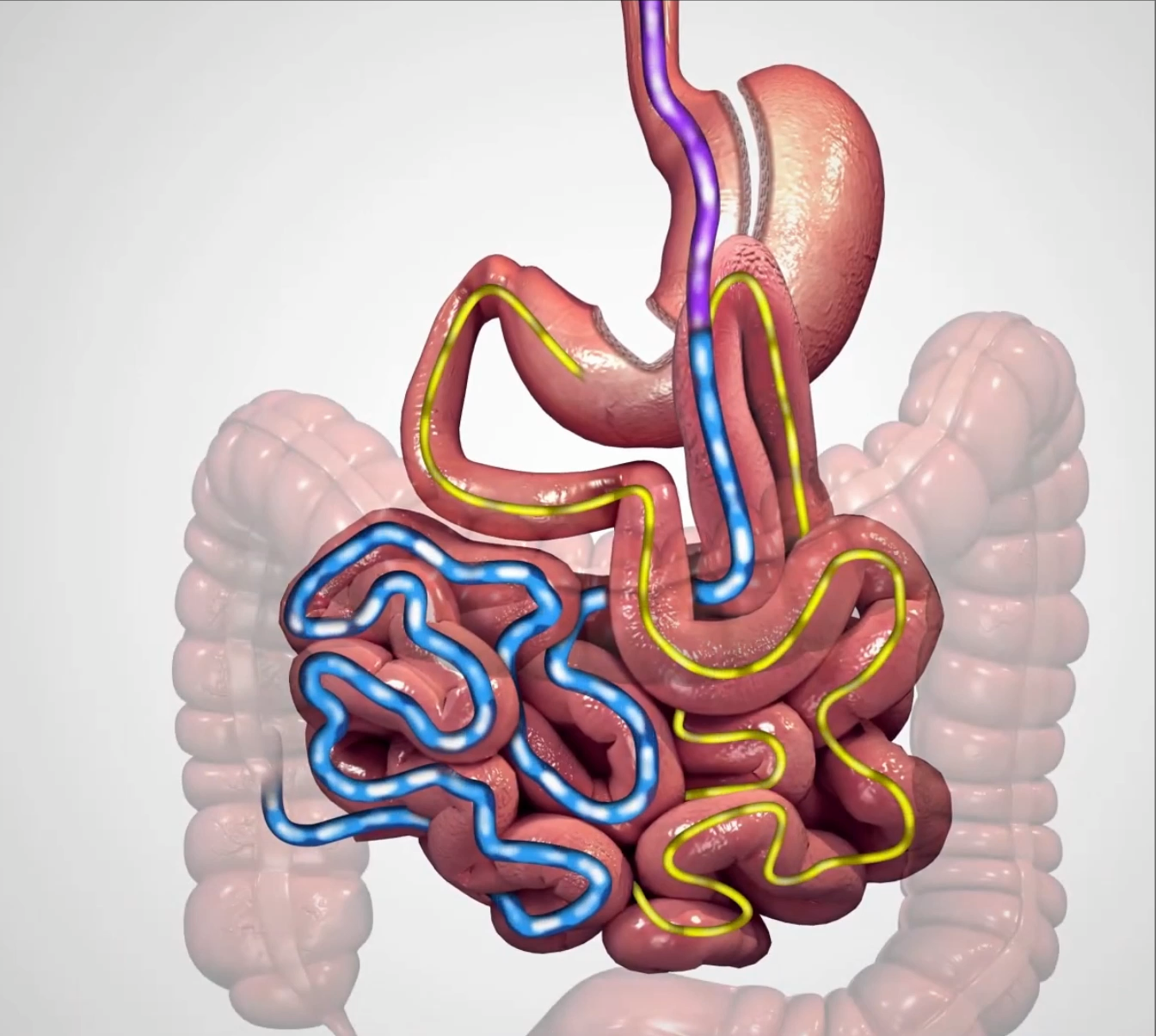
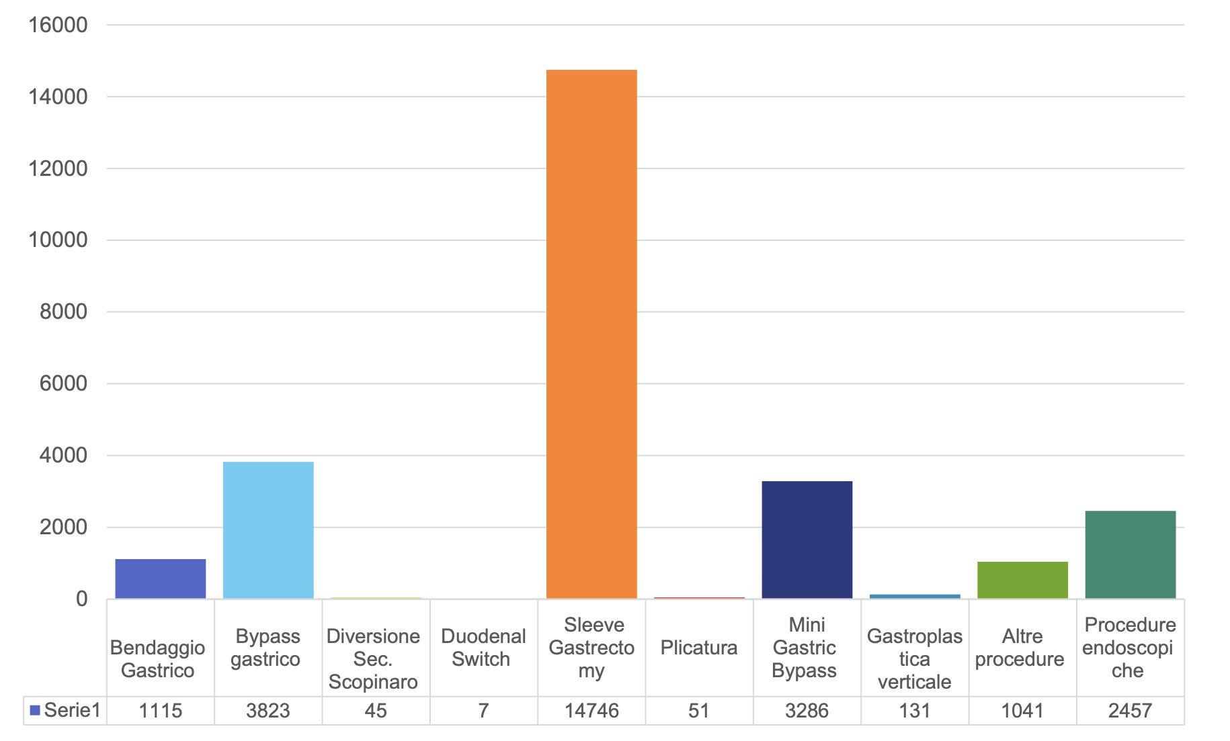
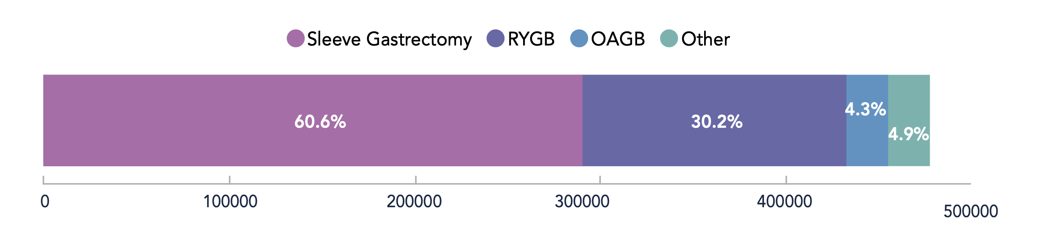
3rd most performed bariatric surgery
12% in Italy
4,3% Worldwide
8th IFSO Registry
Indagine Conoscitiva SICOB 2024

Slide 3
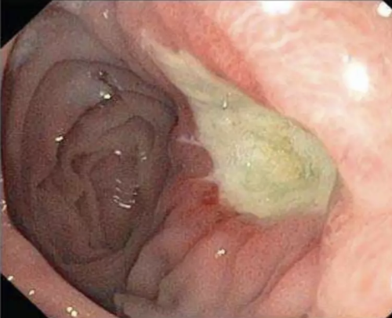
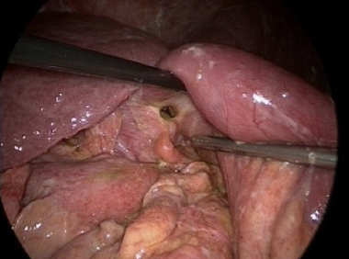
ULCERA MARGINALE
An ulceration of any depth at or near the gastrojejunal (GJ) anastomosis

Slide 4
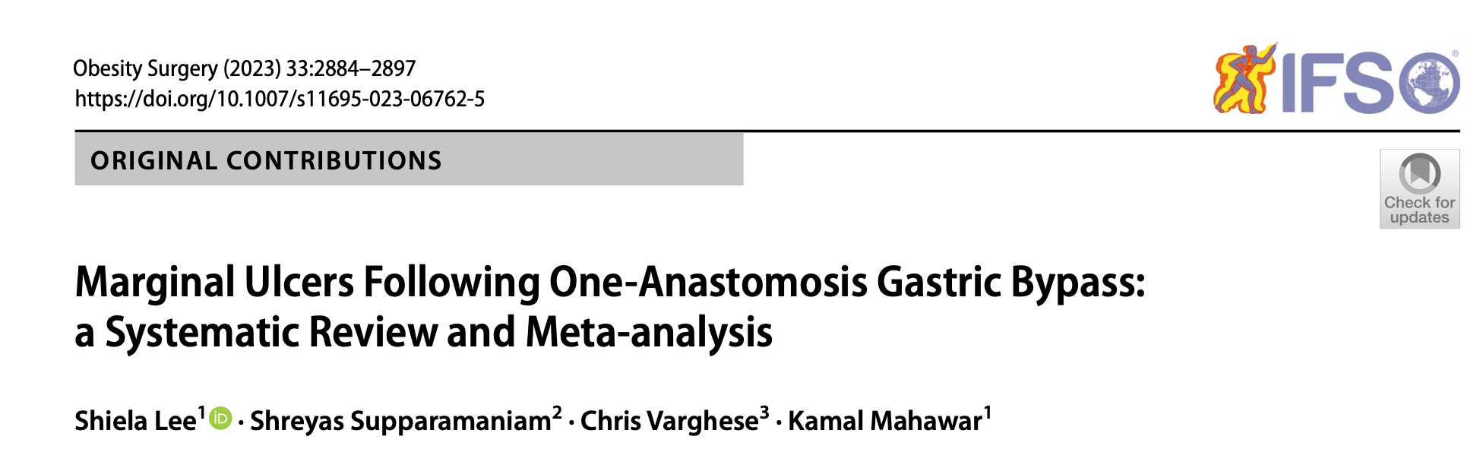
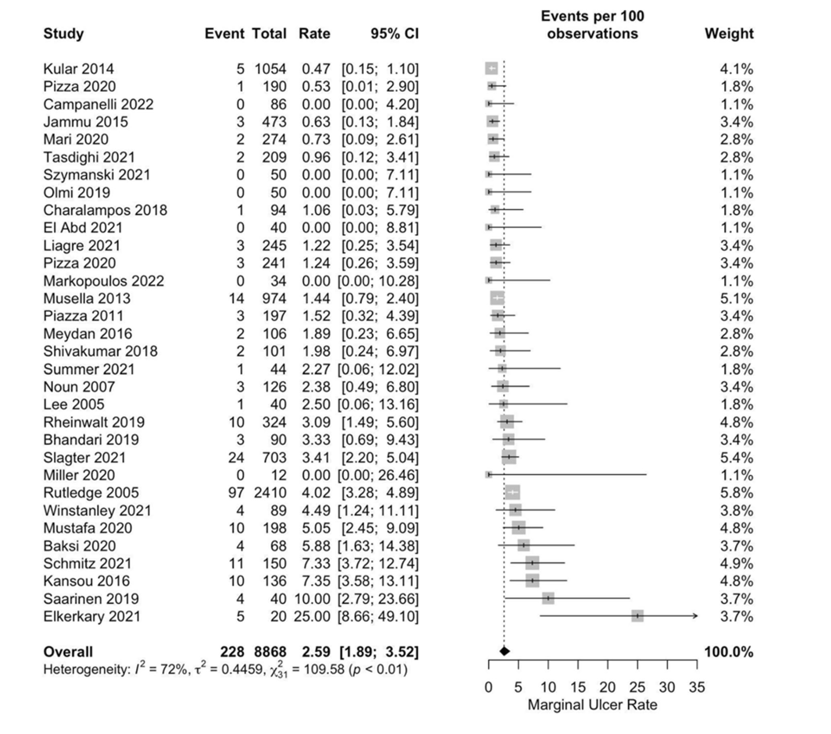
Incidenza 2-3%
Maggiormente tra 6 e 12 mesi post-intervento
Notes:
11 metanalisi che prendono in considerazione complicanze dopo OAGB confrontato ad altre procedure bariatriche

Slide 5
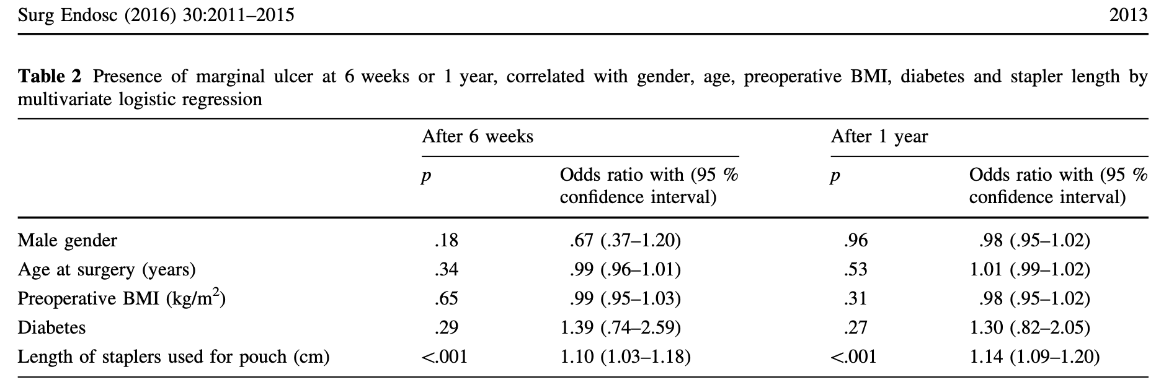
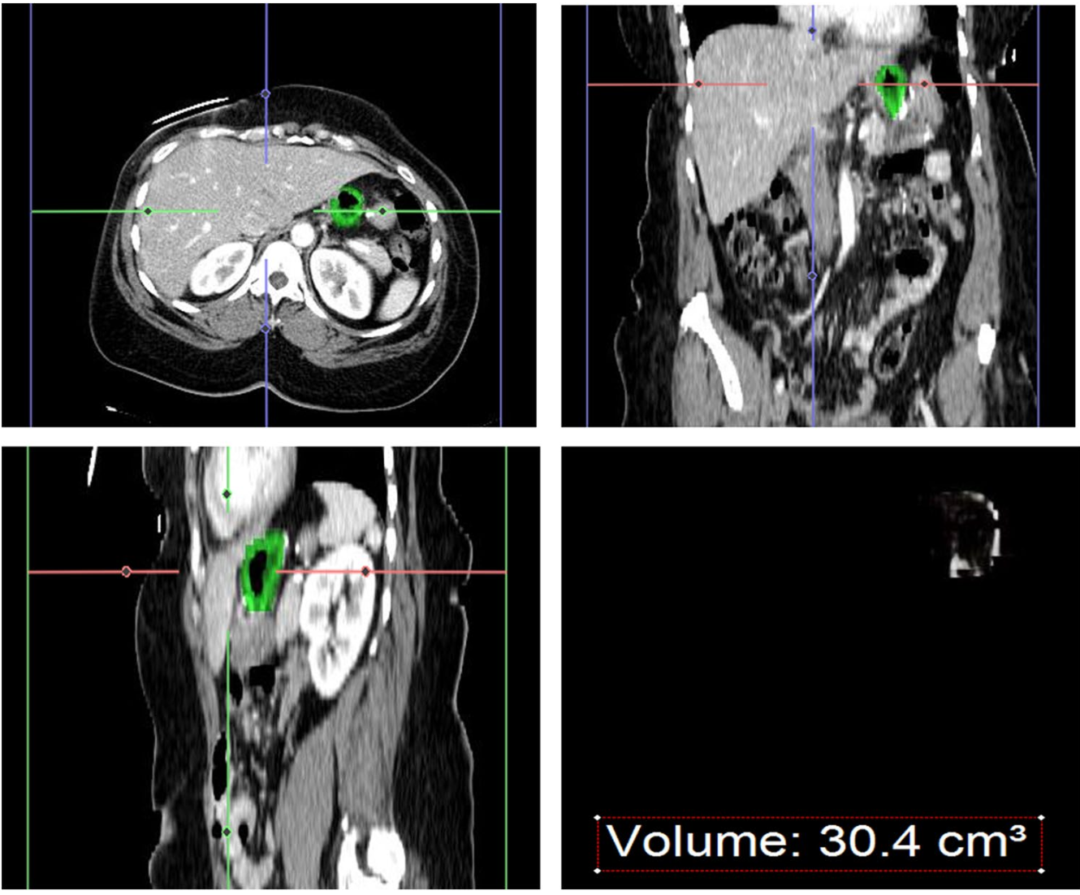
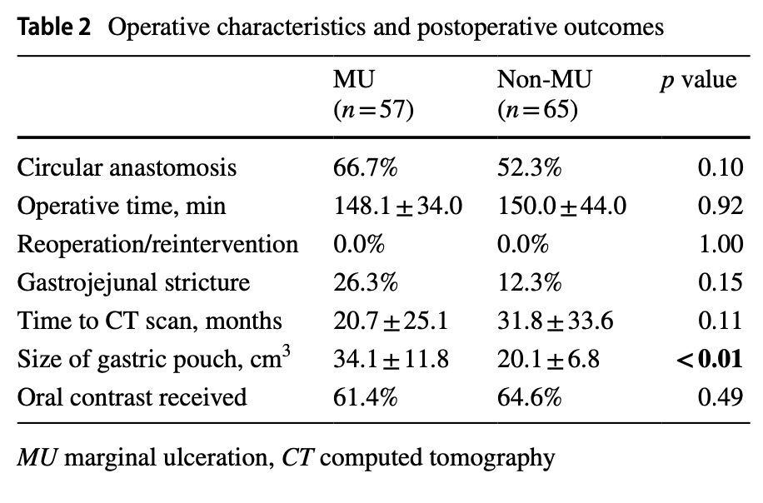
ULCERA MARGINALE - TECHNICAL FACTORS
Pouch size
Gastrojejunal anastomosis
Type of suture
Edholm et al. - Surgical Endoscopy 2016
Ayuso et al. - Obesity Surgery 2023
Notes:
Studio su 14000 pz sottoposti a RYGB, l’incidenza di MU cresceva di pari passo con la grandezza della pouch a causa del maggior numero di cellule parietali che producono acido cloridrico - dibattuto nel mini perché succhi pancreatici alcalini (14% in più per ogni cm).
Studio retrospettivo su 122 pazienti, per ogni 5 cm3 di aumento della pouch size, 2.4 volte probabilità di sviluppare MU

Slide 6
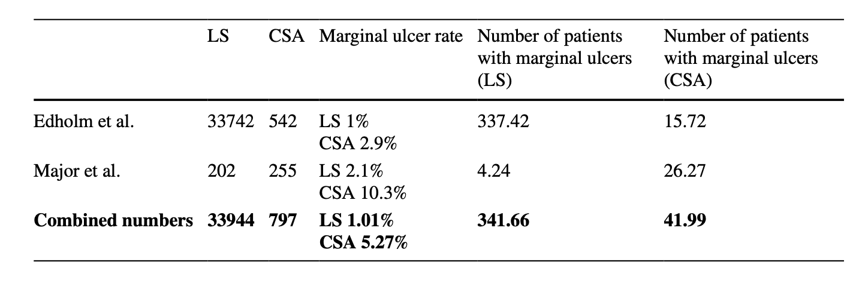
ULCERA MARGINALE - TECHNICAL FACTORS
Pouch size
Gastrojejunal anastomosis
Type of suture
Notes:
Molti studi mostrano come un’anastomosi circolare rappresenti un maggior rischio di sviluppare MU.
marginal ulcer rate is generally higher in the CSA group due to the permanent nature of titanium staples, which unlike the absorbable sutures used in HSA, can erode the integrity of the mucosal barrier leading to ulceration.

Slide 7
ULCERA MARGINALE - TECHNICAL FACTORS
Pouch size
Gastrojejunal anastomosis
Type of suture
Rischio minore con suture assorbibili rispetto alle non riassorbibili
1,3% vs 2,6% (p < 0,01)

Slide 8



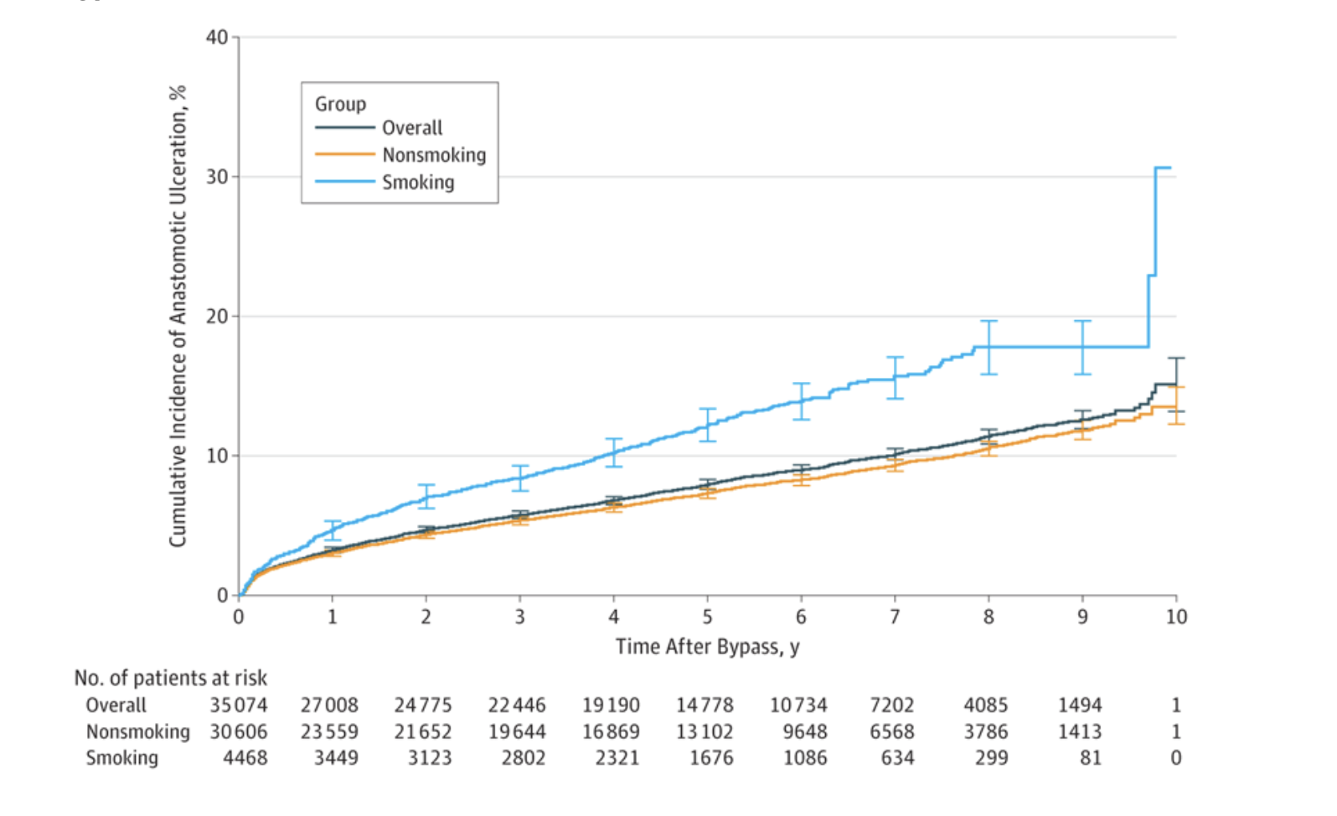
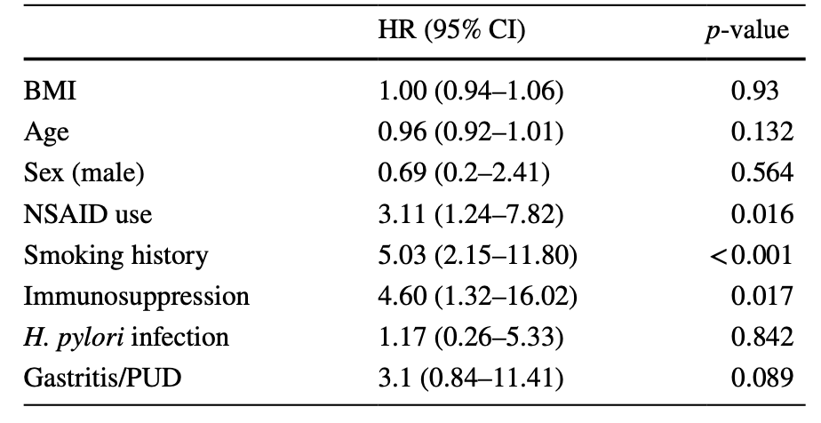
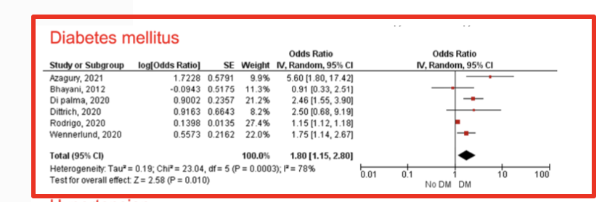
ULCERA MARGINALE - PATIENT FACTORS
Spaniolas et al., YAMA Surgery, 2018
Di Palma et al, Surgical Endoscopy, 2001
Beran et al. J.GI Surgery 2023
Notes:
-Studio retrospettivo di 35mila pazienti, il fumo aumentava del 56% il rischio di sviluppare ulcere marginali
-2800 pazienti, rischio aumentato di 3,1 volte nei pazienti che usano nsaid
-Metanalisi 14 studi

Slide 9

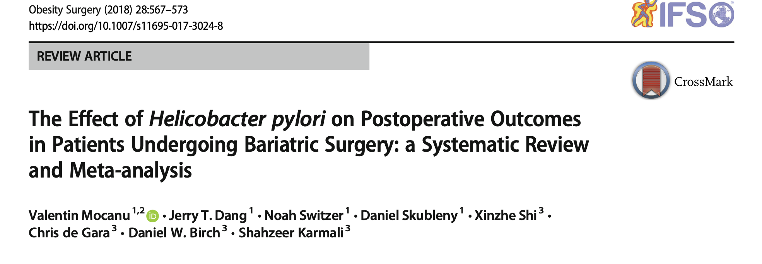
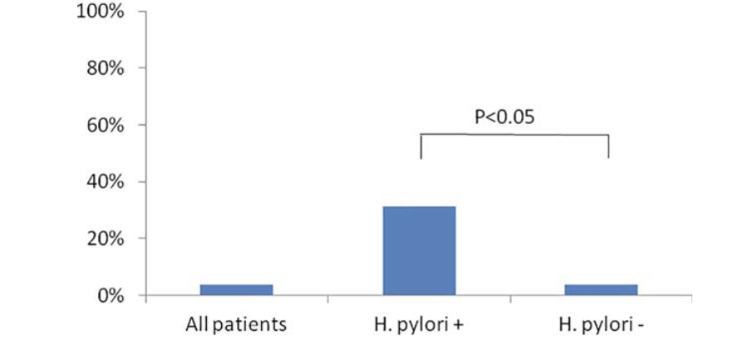
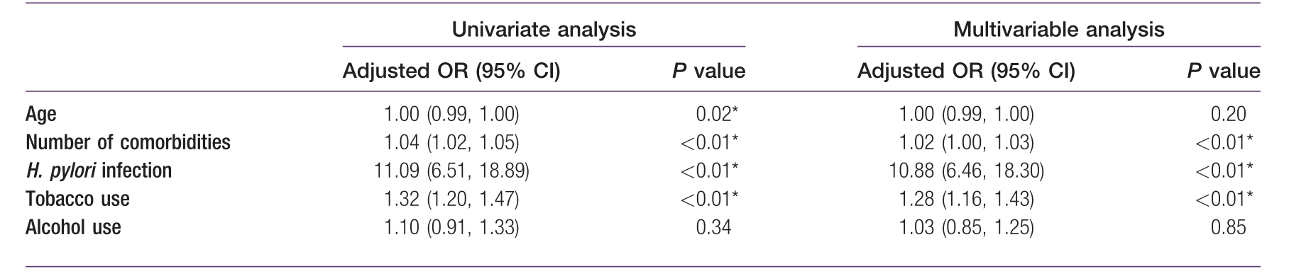
ULCERA MARGINALE - H. PYLORI
Schulman et al. Obesity 2017
Notes:
Incidenza aumentata di 10 volte in pazienti con H pylori
Studio retrospettivo Final multivariate regression analysis revealed that H. pylori was the strongest independent predictor of
marginal ulceration.

Slide 10

ULCERA MARGINALE - REFLUSSO BILIARE
Creates an ulcerogenic environment: The constant exposure of the surgical anastomosis to bile and pancreatic juices creates an irritative, alkaline environment that can damage the delicate mucosal lining.
Leads to chronic inflammation: This persistent irritation can trigger a chronic inflammatory process in the mucosa around the anastomosis, making it more vulnerable to ulceration.
Impedes healing: The ongoing inflammatory process caused by bile can interfere with the natural healing of any existing ulcer, prolonging its duration and potentially leading to recurrence.
Combined with other risk factors: The damage from bile reflux is often compounded by other factors, such as smoking, diabetes, and the use of nonsteroidal anti-inflammatory drugs (NSAIDs), which further compromise the integrity of the tissue and increase the risk of developing ulcers.

Slide 11
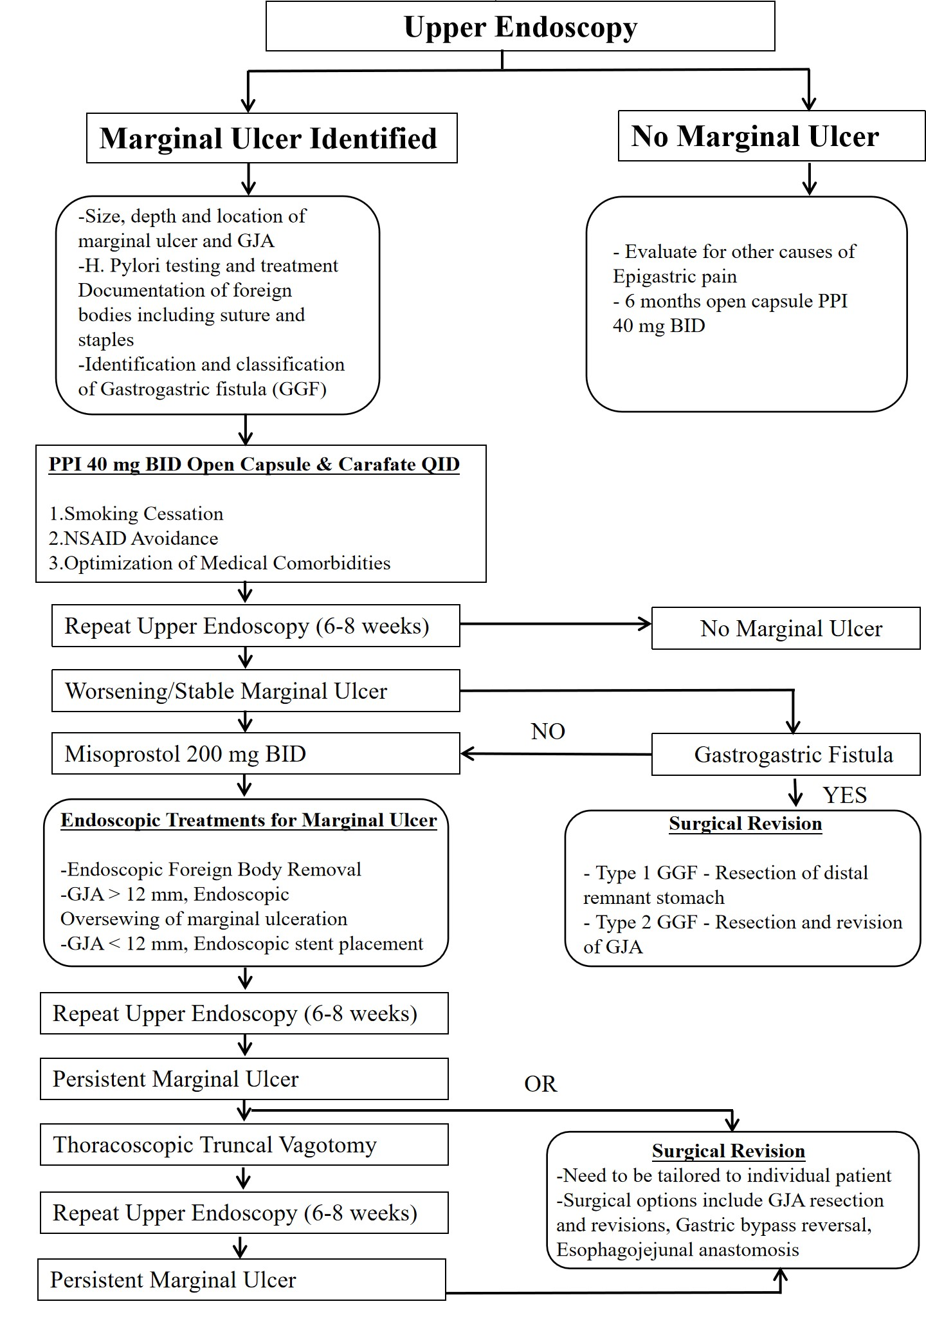
ULCERA MARGINALE
MANAGEMENT
ANAMNESIS
SYMPTOMS
ENDOSCOPY

Slide 12
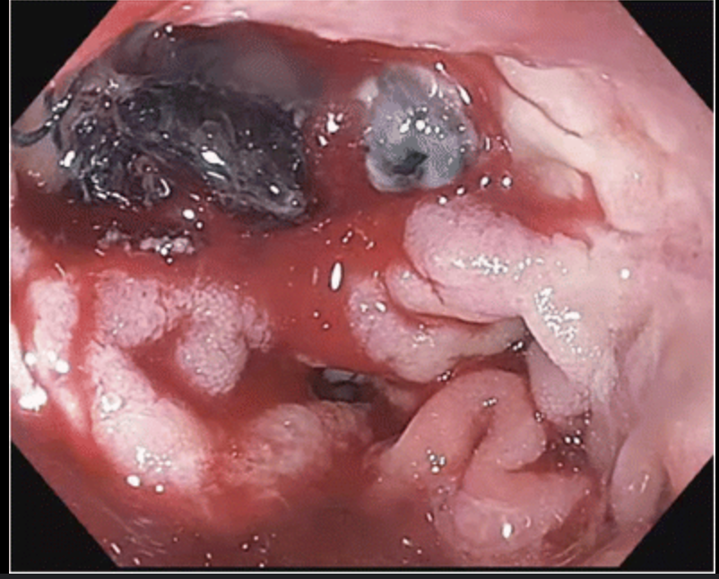
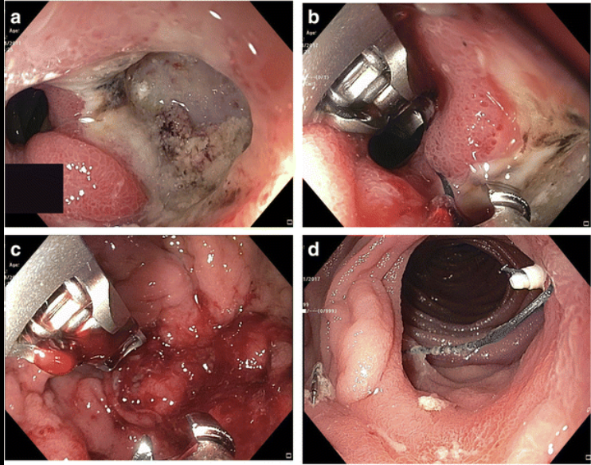
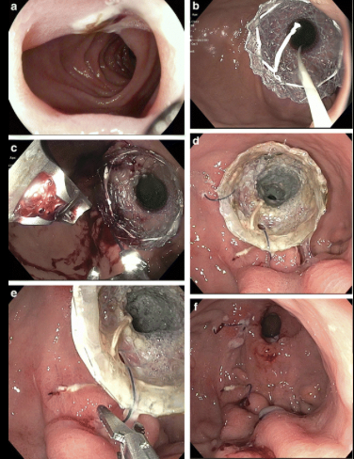
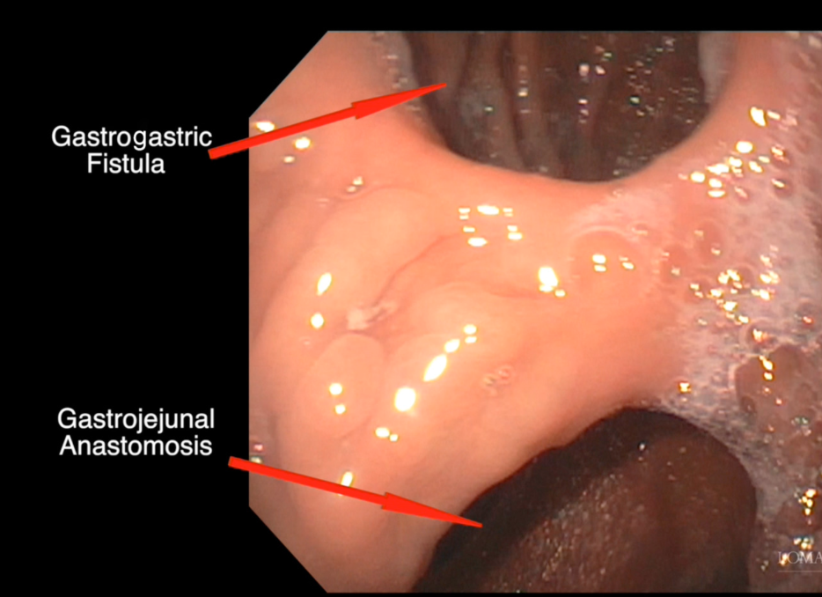
ULCERA MARGINALE - ENDOSCOPIC TREATMENT

Slide 13


ULCERA MARGINALE - SURGICAL TREATMENT
Emergency surgery
Elective surgery
-Conversion to RYGB
-Vagotomy
-Resection and new anastomosis
-Omental patch
-Resection and new anastomosis

Slide 14
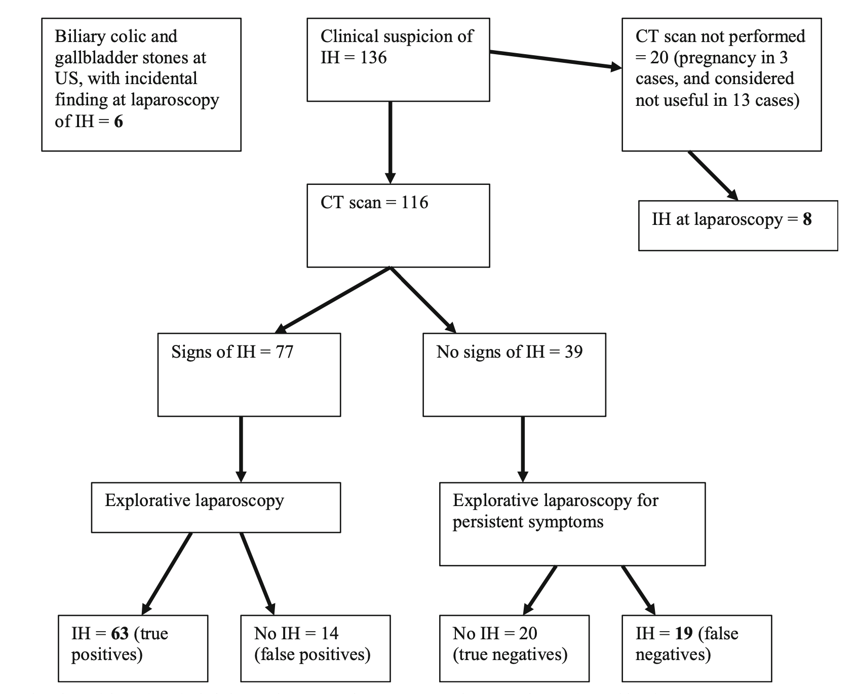
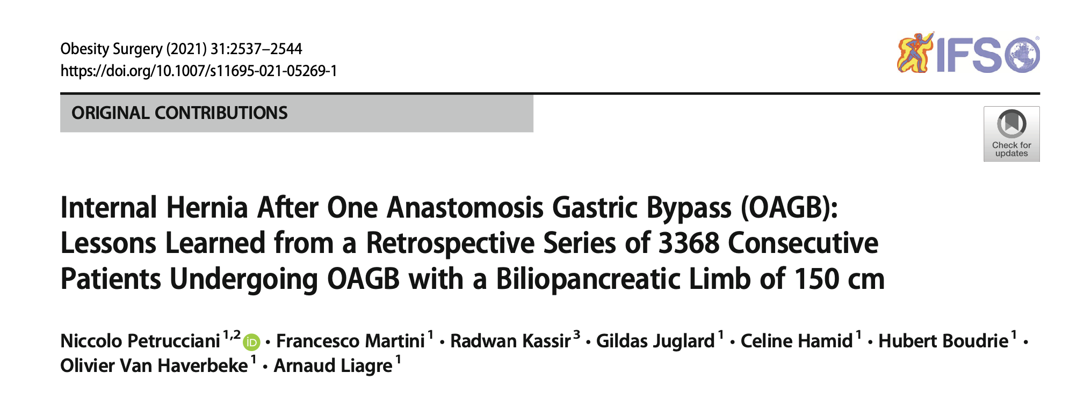
ERNIA INTERNA
2,8% incidence
96% resolved laparoscopically
9,3% hypovascularization
47,3% 180° of the GJ anastomosis
No bowel resections
100% closure of the Petersen orifice
Notes:
Studio retrospettivo su 3368 pazienti sottoposti a OAGB. Di questi 96 hanno avuto ernia interna, tutti a livello del Petersen.
Nessuno ha avuto bisogno di resezione intestinale, anche se 9 avevano segni di ipovascolarizzazione.
Chiusura del Petersen e riposizionamento dell’ansa (96% laparo).
Nel 77% ansa comune, 23% ansa biliare
In 47.3% of patients, we observed at laparoscopy a 180° torsion of the gastrojejunal anastomosis due to quasi-complete incarceration of the common limb. This observation is peculiar to OAGB: only a single point of fixa- tion exists for the presence of a single anastomosis and the weight of the herniated bowel may easily cause rotation of the anastomosis.

Slide 15
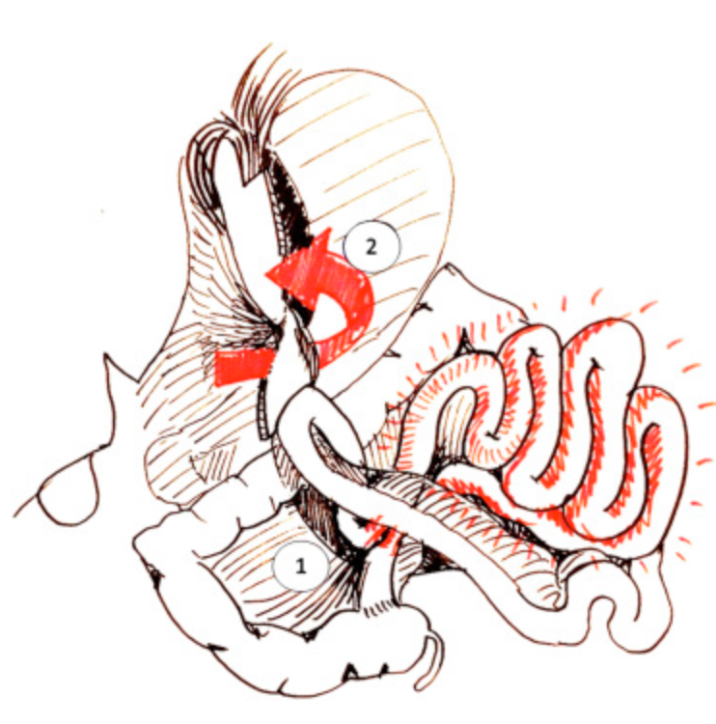
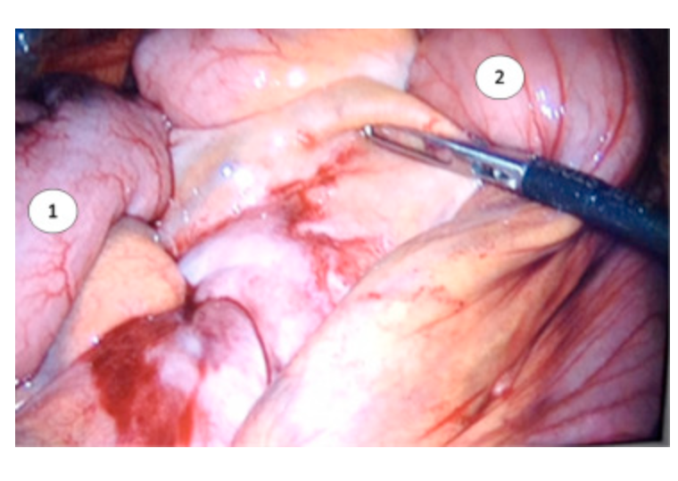
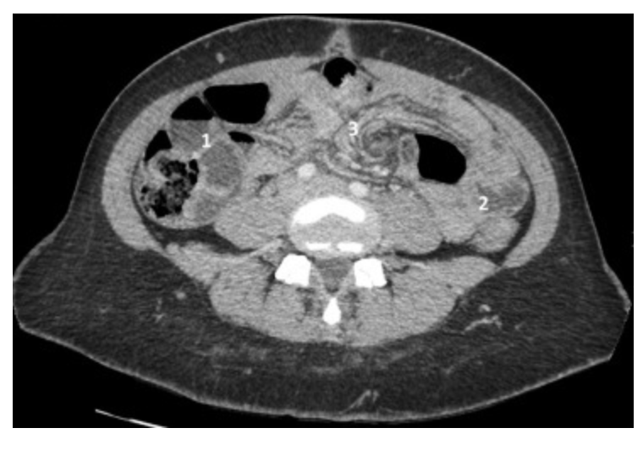
ERNIA INTERNA
Genser, Laurent et al,
Surgery for Obesity and Related Diseases, 2015
Notes:
Case report

Slide 16
ERNIA INTERNA - MANAGEMENT
Chronic and intermittent abdominal pain, especially in LUQ, and also nausea especially after meal, can be a presentation of IH also after OAGB.
EXPLORATIVE
LAPAROSCOPY
CT SCAN
DEROTATION &
CLOSURE OF THE DEFECT

Slide 17

Grazie dell’attenzione

